Slide 1
Year 9 Science Daily Review Slides

Slide 2
Repeat the opposite word/phrase.
CONDUCTION
ENERGY TRANSFERRED BY DIRECT CONTACT

Slide 3
Repeat the opposite word/phrase.
CONVECTION
ENERGY THAT IS TRANSFERRED THROUGH A FLUID WHERE HOT RISES AND COLD SINKS

Slide 4
Repeat the opposite word/phrase.
RADIATION
ENERGY TRANSFERRED IN WAVES OR PARTICLES

Slide 5
Conduction, Convection, or Radiation?
Feeling heat from a stove without touching it

Slide 6
Conduction, Convection, or Radiation?
Chocolate candy melting in your hand.

Slide 7
Conduction, Convection, or Radiation?
Boiling water moving in a circular motion.

Slide 8
Repeat the opposite word/phrase.
SOUND
VIBRATIONS THAT TRAVEL THROUGH THE AIR OR OTHER MEDIUMS

Slide 9
Repeat the opposite word/phrase.
MEDIUM
SOLID, LIQUID, OR GAS

Slide 10
Repeat the opposite word/phrase.
LONGITUDINAL WAVE
BACK-AND-FORTH MOTION PUSHES AIR PARTICLES TOGETHER OR APART

Slide 11
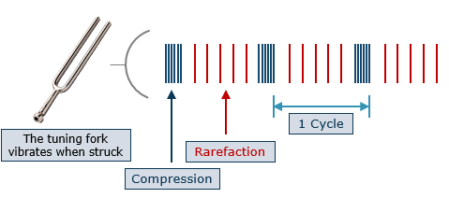
Repeat the opposite word/phrase.
COMPRESSION
PARTICLES PUSHED TOGETHER

Slide 12
Repeat the opposite word/phrase.
RAREFACTION
PARTICLES MOVING APART

Slide 13

Repeat the opposite word/phrase.
AMPLITUDE
THE LOUDNESS OF A SOUND WAVE

Slide 14

Repeat the opposite word/phrase.
FREQUENCY
THE NUMBER OF TIMES A SECOND A SOUND WAVE REPEATS ITSELF

Slide 15
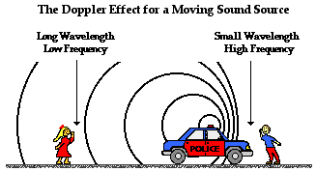
A
C
B
D

